Slide 1
HF11 Study Lipidomics Analysis
Meeyoung Park
05/20/2016

Slide 2
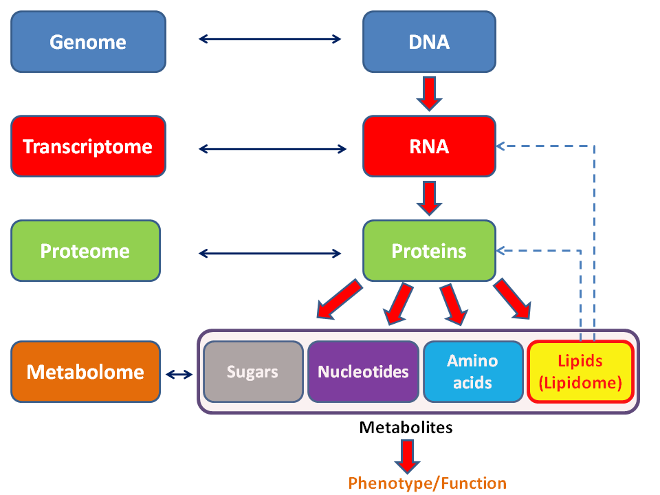
Lipidome

Slide 3
Lipidomics
Definitions
A sub-discipline of metabolomics
The large-scale study of non-water-soluble metabolites (lipids) that utilize system-level analysis to characterize lipids and their interacting moieties
Research Approaches
Targeted lipidomics
Untargeted lipidomics

Slide 4
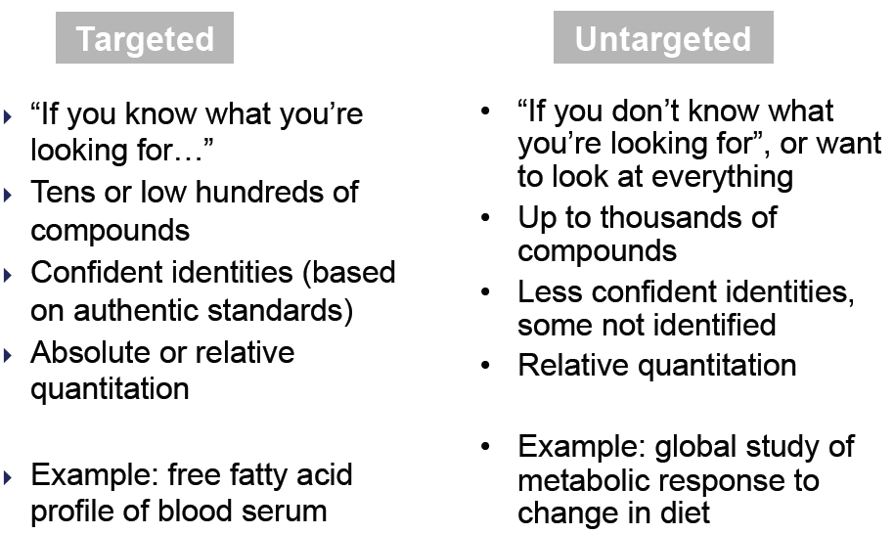
Targeted/Untargeted lipidomics
Courtesy of Charles Evans

Slide 5
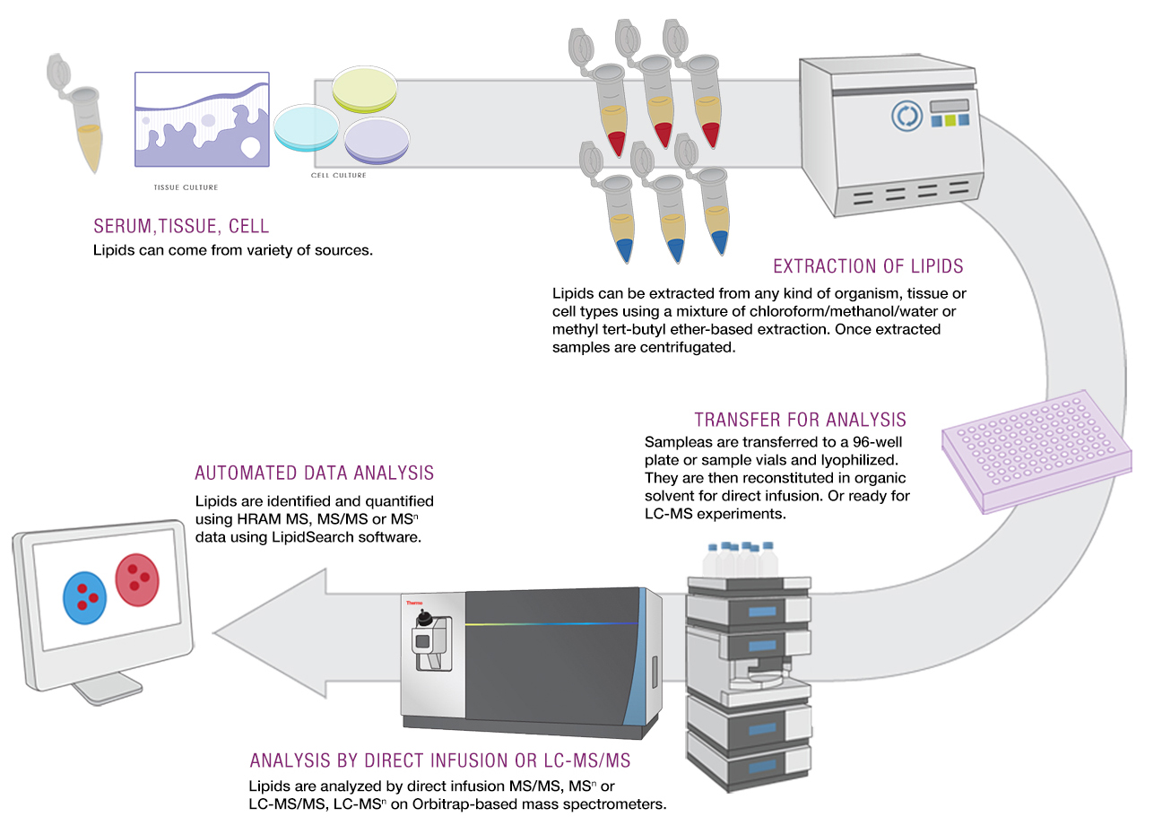
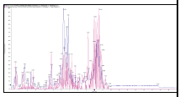
Untargeted Lipidomics Analysis
Data Analysis
http://planetorbitrap.com/untargeted-lipidomics

Slide 6
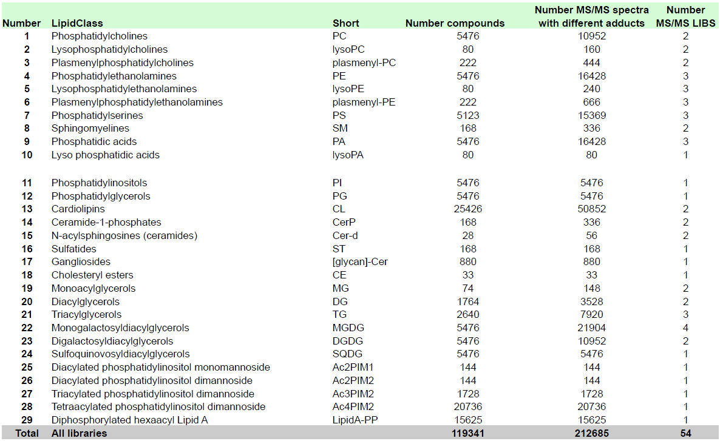
Lipid Classes (LipidBlast)

Slide 7
Data Analysis Workflow
Raw data
Quality Control
Normalization
Basic Analysis
Biomarker Identification
Pathway Analysis

Slide 8
Raw data processing
Normalization
Quality control: CV <= 30%
Removing redundant lipid species
Removing irrelevant lipid classes for a specific mode
Removing odd number of carbon chains
Combining positive and negative modes
Grouping by classes

Slide 9
HF#11 Study
Goals
To examine lipids changes in different strains between normal and high-fat induced mice
To examine lipids changes in different tissues between normal and high-fat induced mice
To identify differentially altered lipids (DALs) between normal and high-fat induced mice

Slide 10
Raw Data
Strains
BL6, BKS, BTBR
Tissue
SCN, Liver, Plasma
Condition
WT, WT-HF (54%), db/+, db/+ HF (54%)
Samples
Each group: 4 mice

Slide 11
Comparative Analysis
Lipid Class Analysis
Between tissues: SCN, Liver, Plasma
Between strains: BL6, BKS, BTBR
Between conditions
WT vs. WT-HF
db/+ vs. db/+ HF
Lipid Species Analysis (SCN WT BL6)
Differential Analysis
Classification
Notes:
You will need to explain what these mean to Lucy/Eva

Slide 12
Quality Control Results
 | SCN_Pos | SCN_Neg | Liver_Pos | Liver_Neg | Plasma_Pos | Plasma_Neg
Total Number of Lipids | 579 | 388 | 799 | 540 | 603 | 353
<= 10 | 145 (25%) | 89 (23%) | 263 (33%) | 63 (12%) | 121 (20%) | 52(15%)
<= 20 | 311 (54%) | 208 (54%) | 473 (59%) | 217 (40%) | 263 (44%) | 162 (46%)
<= 30 | 424 (73%) | 293 (76%) | 599 (75%) | 348 (64%) | 418 (69%) | 259 (73%)
CV <= 30 | 424 | 293 | 599 | 348 | 418 | 259
Combined (Pos/Neg) # | 717 |  | 947 |  | 677
Final # | 249 |  | 330 |  | 249

Slide 13
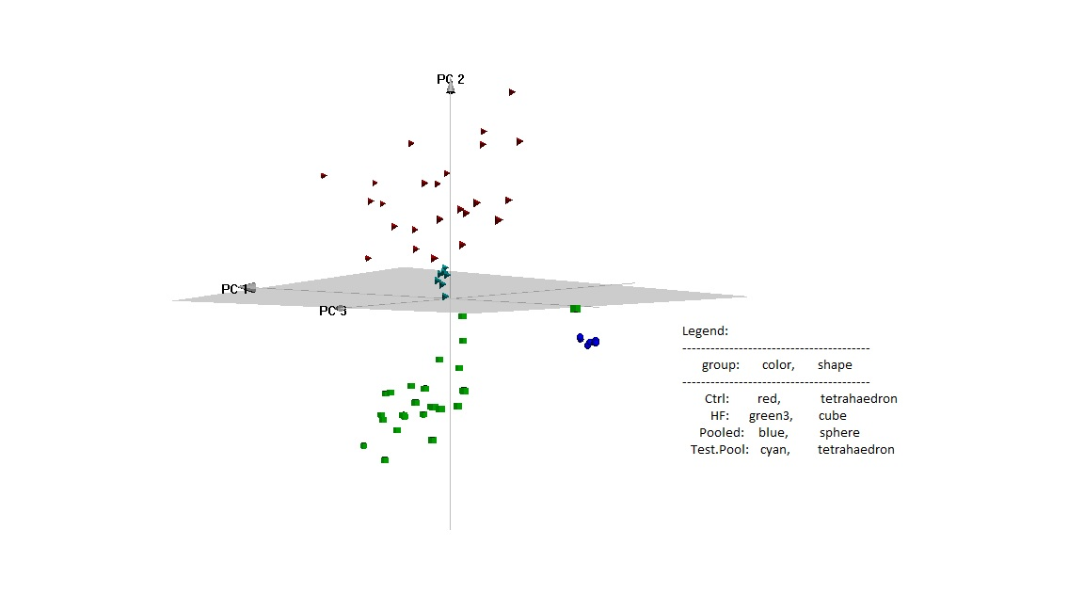
Principal Component Analysis (PCA)

Slide 14
All groups for SCN
Log2(value)
BKS-WT
BKS-db/+
BL6-WT
BL6-db/+
BTBR-WT
BTBR-db/+

Slide 15
All groups for Liver
Log2(value)
BKS-WT
BKS-db/+
BL6-WT
BL6-db/+
BTBR-WT
BTBR-db/+

Slide 16
All groups for Plasma
Log2(value)
BKS-WT
BKS-db/+
BL6-WT
BL6-db/+
BTBR-WT
BTBR-db/+

Slide 17
Distribution of Lipid Classes
SCN
Liver
Plasma

Slide 18
SCN WT
BL6
BKS
BTBR

Slide 19
SCN db/+
BL6
BKS
BTBR

Slide 20
Liver WT
BL6
BKS
BTBR

Slide 21
Liver db/+
BL6
BKS
BTBR

Slide 22
Plasma WT
BL6
BKS
BTBR

Slide 23
Plasma db/+
BL6
BKS
BTBR

Slide 24
Principal Component Analysis (PCA)

Slide 25
Correlation Analysis for each tissue by strain

Slide 26
BL6 WT
SCN
Liver
Plasma

Slide 27
BKS WT
SCN
Liver
Plasma

Slide 28
BTBR WT
SCN
Liver
Plasma

Slide 29
BL6 db/+
SCN
Liver
Plasma

Slide 30
BKS db/+
SCN
Liver
Plasma

Slide 31
BTBR db/+
SCN
Liver
Plasma

Slide 32
SCN WT BL6

Slide 33
Top 10 Highly dysregulated Lipids
P-value < 0.05, |FC| > 1.5
Up-regulated Lipids
Down-regulated Lipids
 | FC | log2(FC) | p.value
TG 54_6 | 4.66 | 2.22 | 0.000138
TG 62_4 | 2.97 | 1.57 | 0.017083
TG 53_4 | 2.78 | 1.48 | 0.003355
TG 53_6 | 2.74 | 1.45 | 0.000395
DG 35_2 | 2.60 | 1.38 | 0.021302
DG 32_0 | 2.46 | 1.30 | 0.013683
TG 60_4 | 2.43 | 1.28 | 0.012058
TG 57_4 | 2.33 | 1.22 | 0.038247
TG 52_6 | 2.31 | 1.21 | 0.018417
DG 37_0 | 2.24 | 1.17 | 0.046146
 | FC | log2(FC) | p.value
PC 44_12 | -2.34 | -1.23 | 0.011022
PC 32_2 | -2.15 | -1.10 | 0.015927
PC 28_0 | -2.13 | -1.09 | 0.03655
lysoPE 14_0 | -2.01 | -1.01 | 0.044554
DG 42_2 | -1.98 | -0.98 | 0.003111
lysoPC 16_0 | -1.91 | -0.93 | 0.018322
TG 48_2 | -1.89 | -0.92 | 0.001897
lysoPC 20_0 | -1.80 | -0.85 | 0.012166
PC 29_0 | -1.77 | -0.83 | 0.017793
DG 38_4 | -1.74 | -0.80 | 0.033636

Slide 34
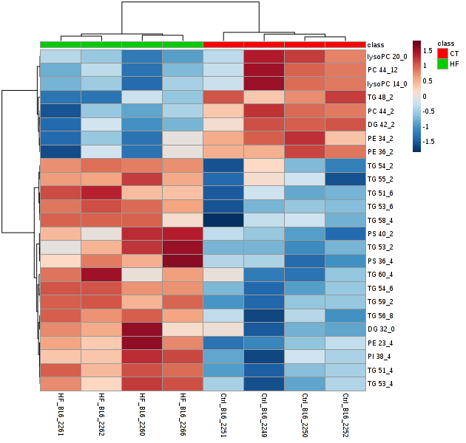
Correlation Analysis
Top 25 Significant Lipids
(T-test P-value <0.05)
Notes:
Is 2251 the potential outlier in the next slide? – animal numbers are truncated

Slide 35
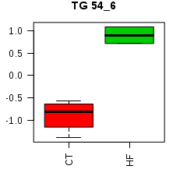
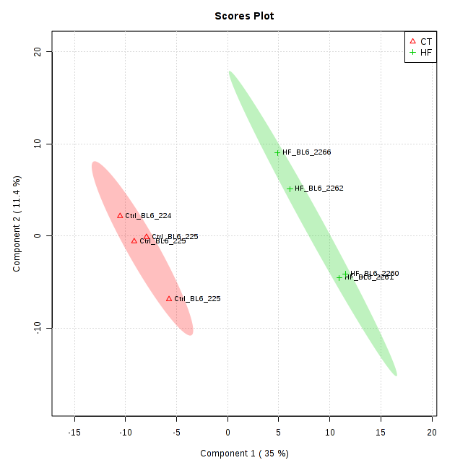
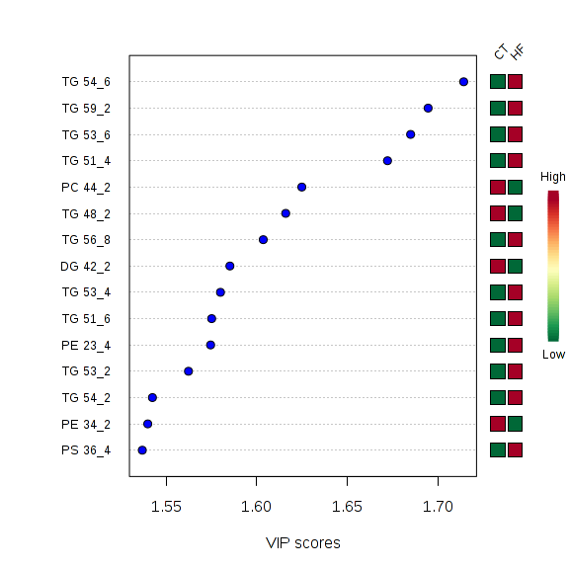
Partial Least Square Discriminant Analysis (PLSDA)

